Slide 1


Num2Verify
Virtual Number Provider

Slide 2
Outline
1- Introduction
2- System Requirements
3- Technologies and Libraries
4- Front-End
5- Back-End
6- Conclusion

Slide 3
Introduction

Slide 4
Introduction
Num2Verify is an innovative platform that provides users with temporary virtual phone numbers to receive account verification messages securely and conveniently.
Whether you're signing up for a new service, creating a social media account, or verifying your identity on various online platforms, Num2Verify offers a seamless solution to ensure your privacy and security.

Slide 5
Introduction
Key features of Num2Verify
Instant access to virtual numbers from multiple countries
Quick and secure SMS reception for verification codes
Enhanced privacy by keeping your personal number private
Easy-to-use interface with seamless functionality

Slide 6
System Requirements
User Registration (Sign Up)
The system should allow new users to create an account by providing necessary details.
User Login (Sign In)
Registered users should be able to log in using their credentials.
Forgot Password
Users who forgot their password should be able to reset it by providing their registered email.
Account Verification
Users Receive a verification code in their email upon registration which they can use to verify their account.

Slide 7
System Requirements
View Countries List
The system should display a list of countries where virtual numbers are available.
Claim a Number
Users should be able to claim a virtual number for receiving account verification messages.
View User's Claimed Numbers
Users should be able to view the virtual numbers they have claimed.
View Number Messages
Users should be able to view messages (e.g., SMS) received by a claimed virtual number.
Delete a Number
Users should be able to delete (release) a virtual number they have claimed.

Slide 8









Technologies and Libraries
HTML
CSS
JavaScript
React
Material UI
NodeJS
MongoDB
ExpressJS
AWS EC2

Slide 9
Front-end

Slide 10
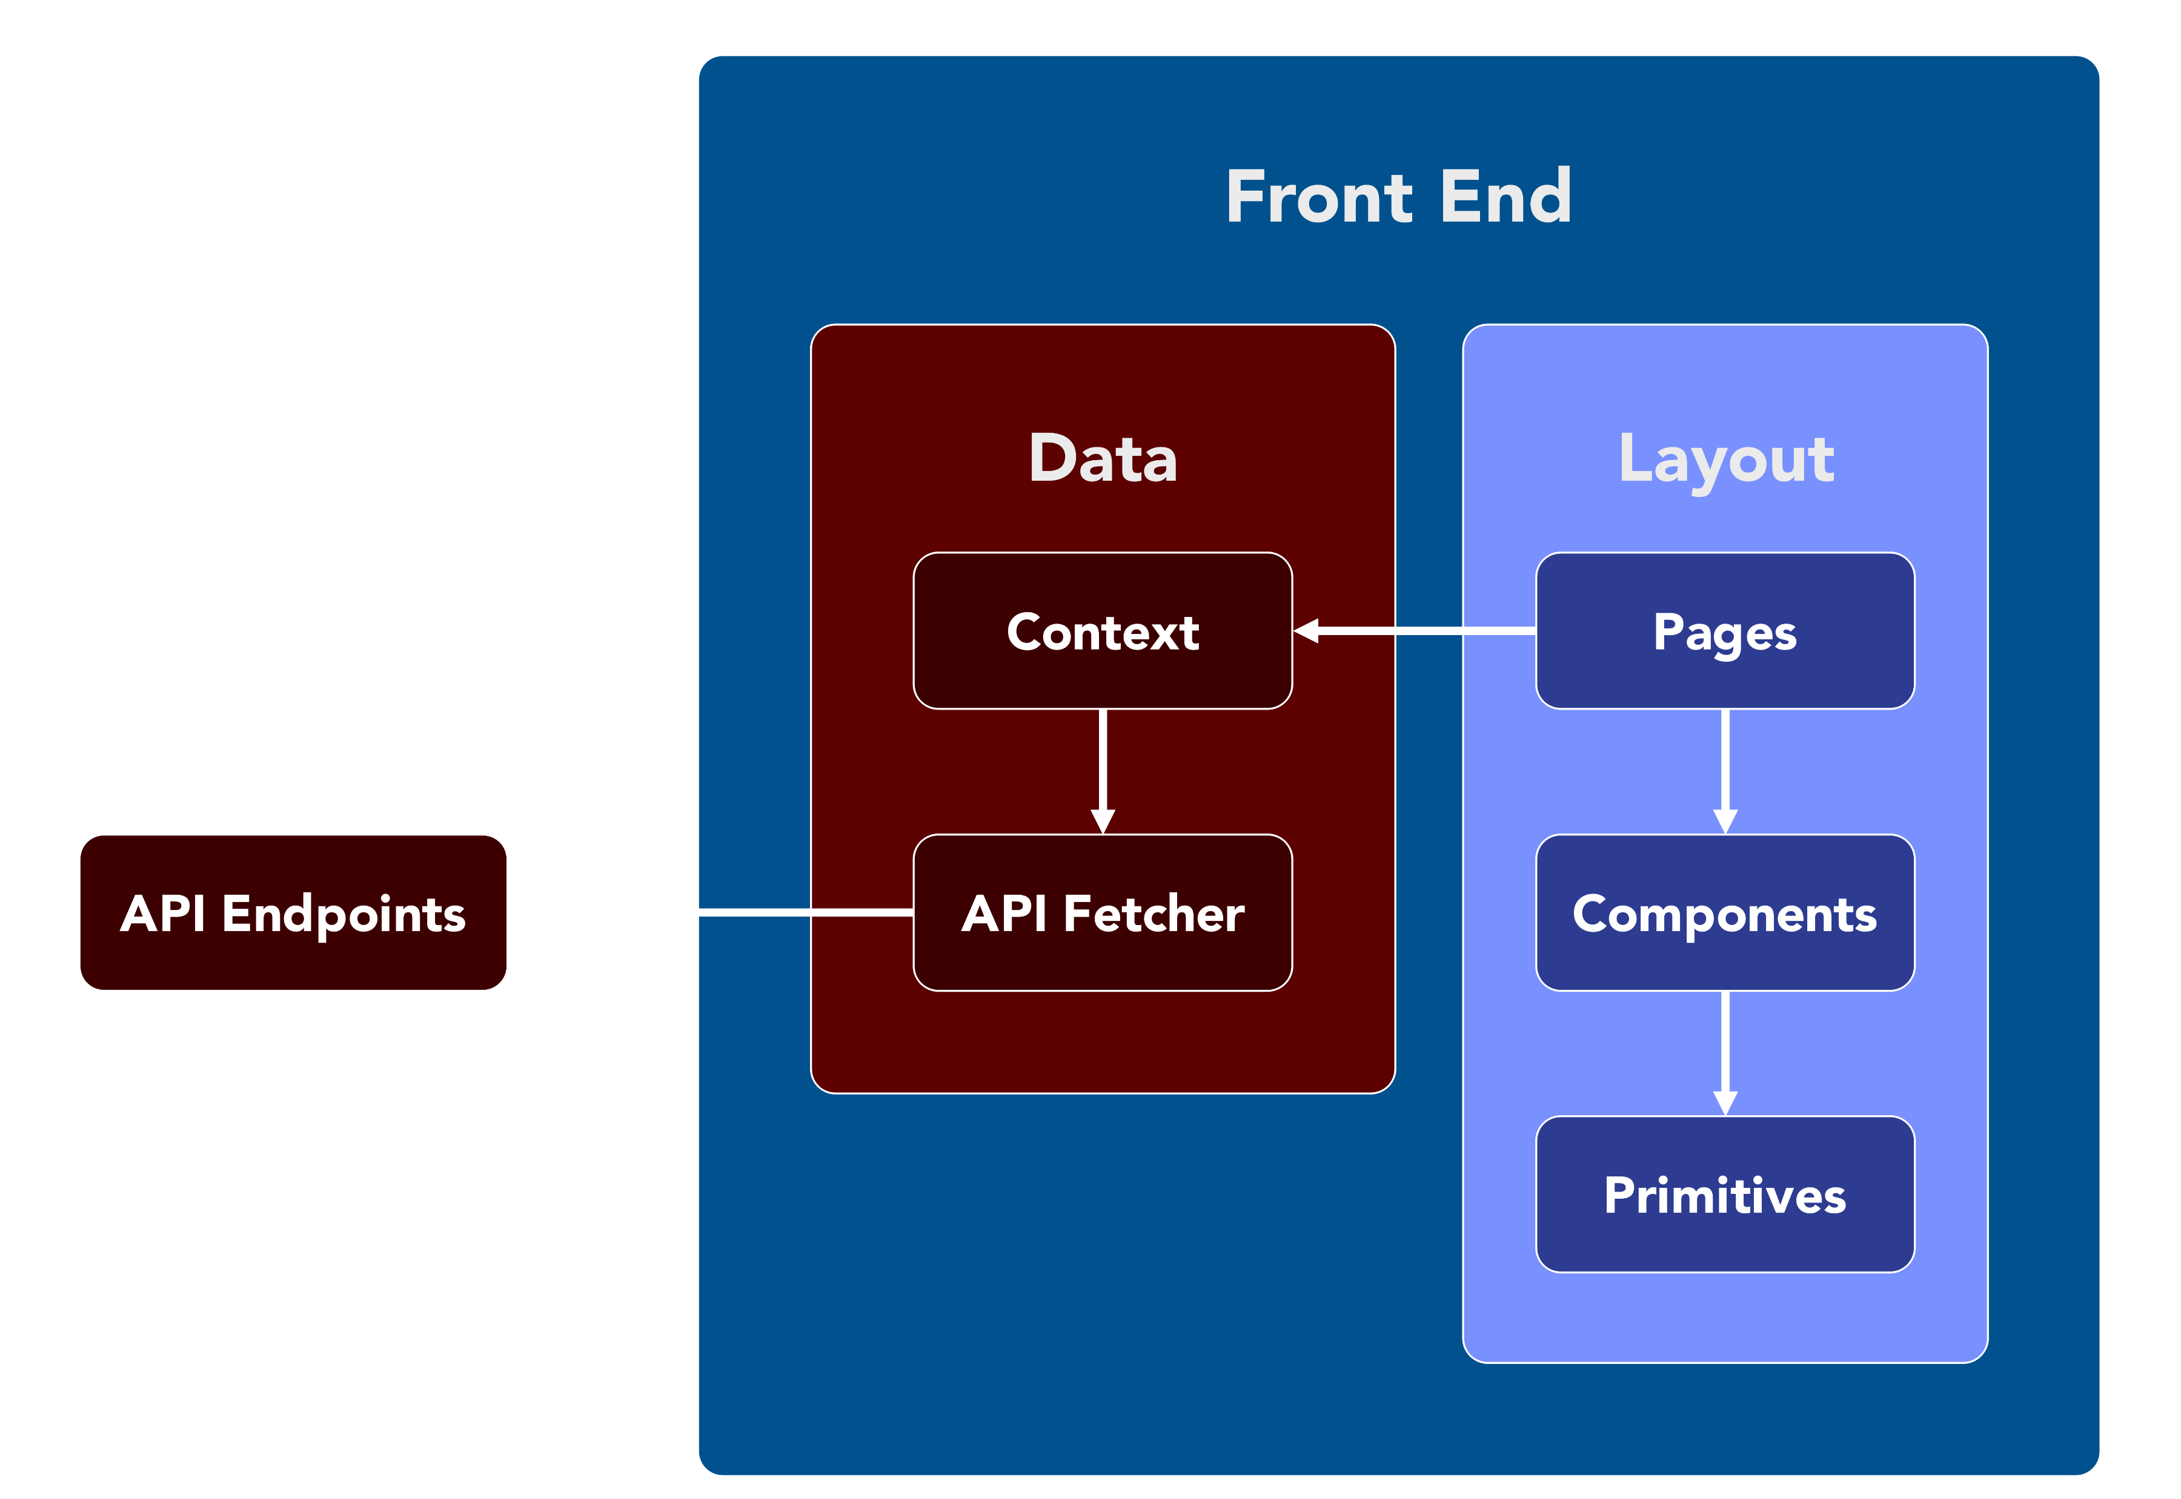
Front-end Structure

Slide 11
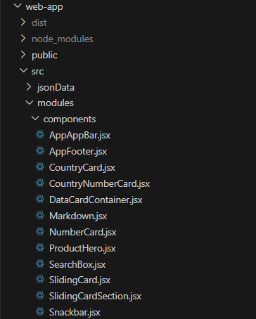
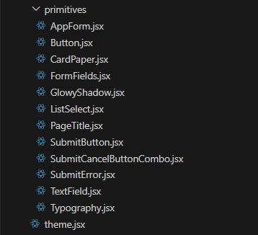
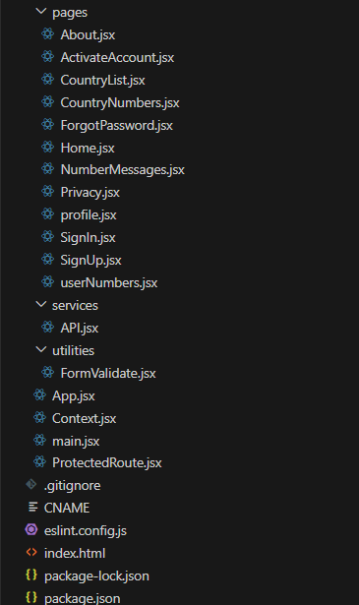
Front-end Code Files

Slide 12
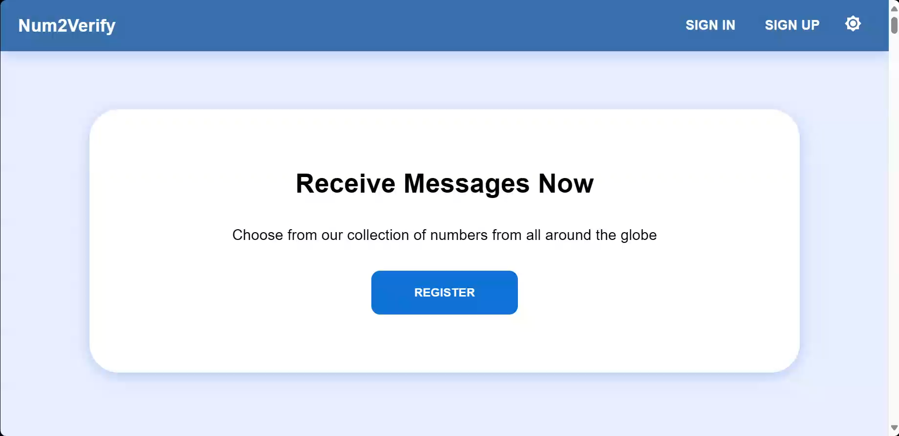
Home Page

Slide 13
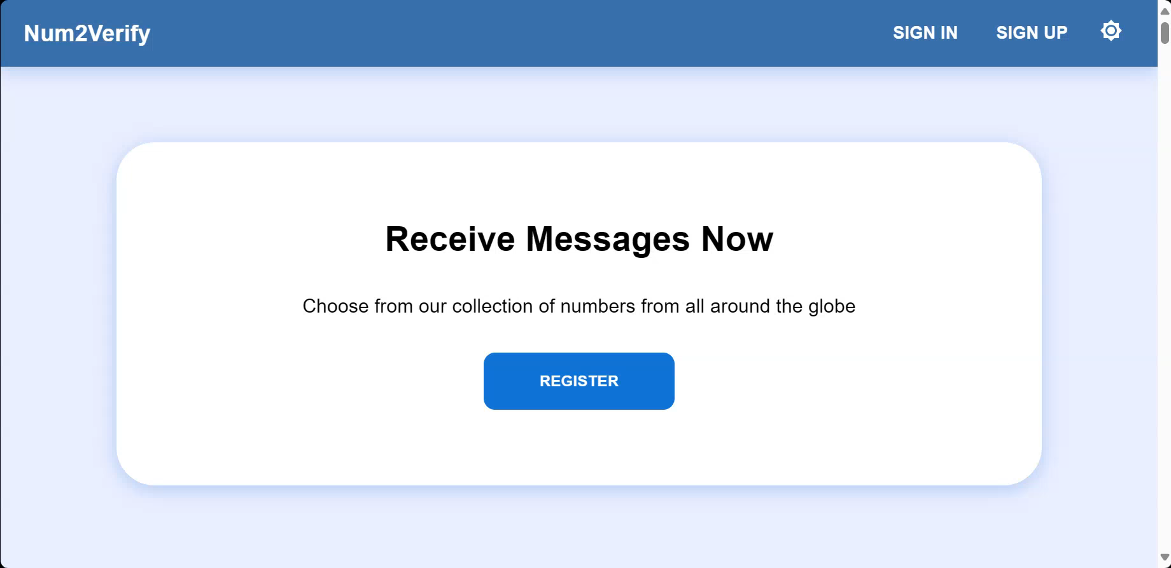
Sign Up

Slide 14
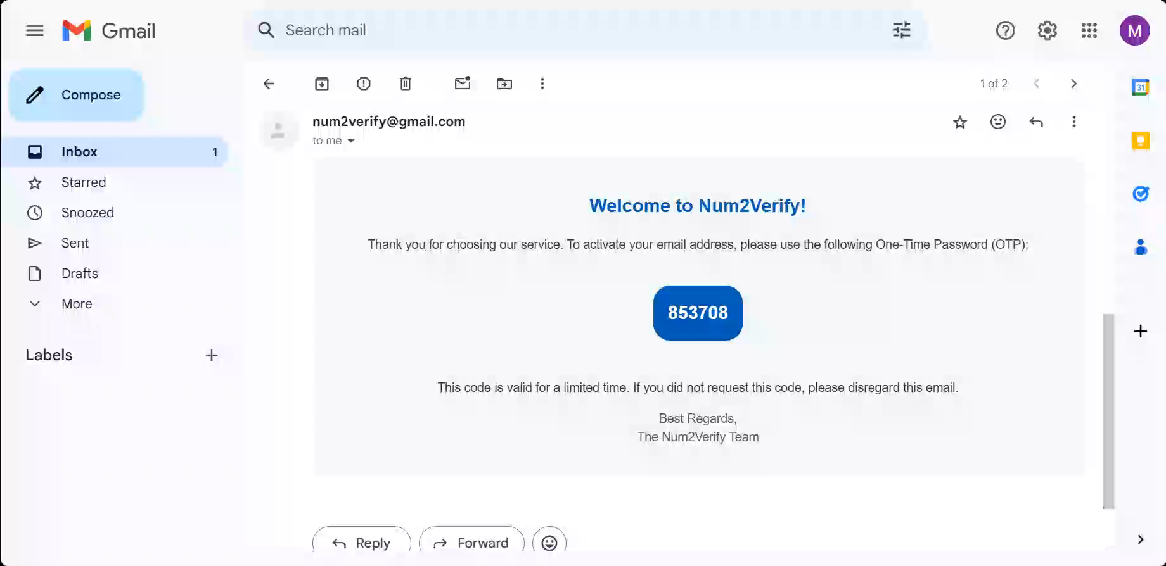
Activation Page

Slide 15
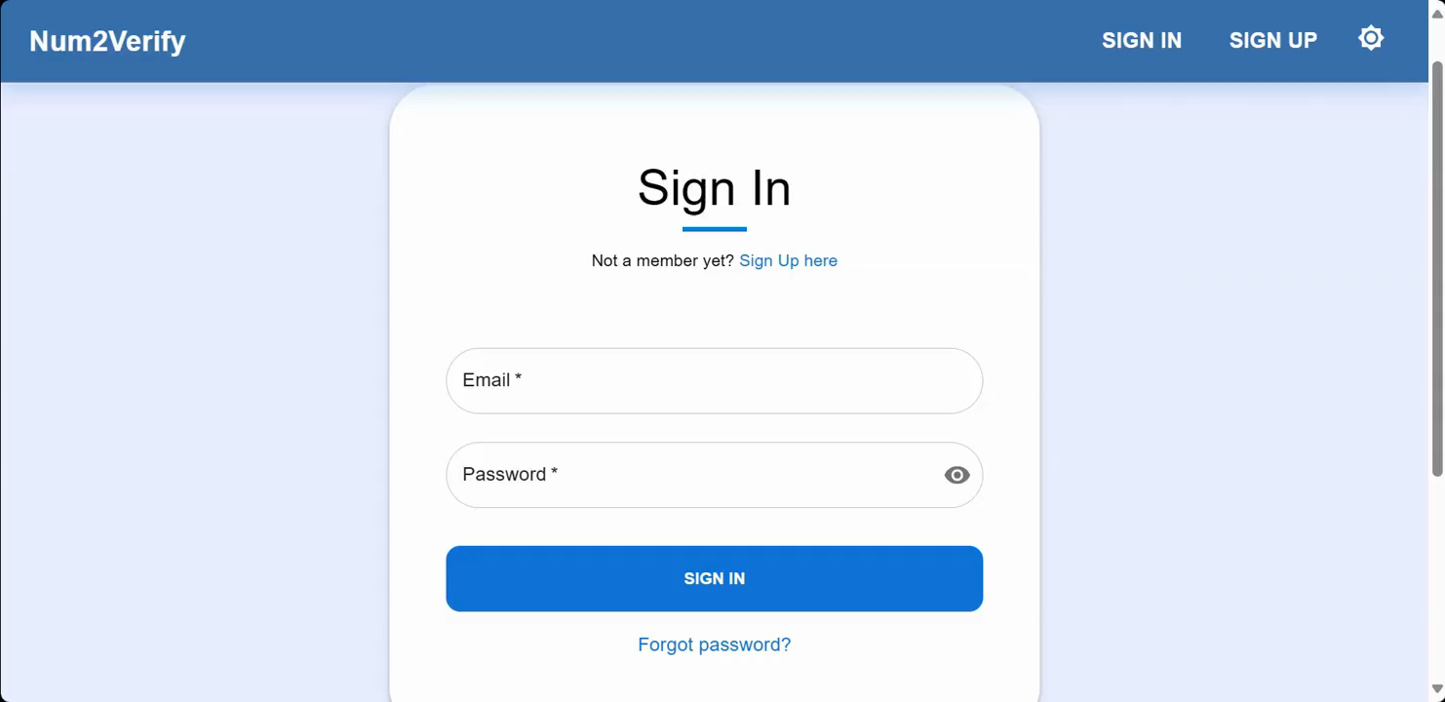
Forgot Password Page

Slide 16
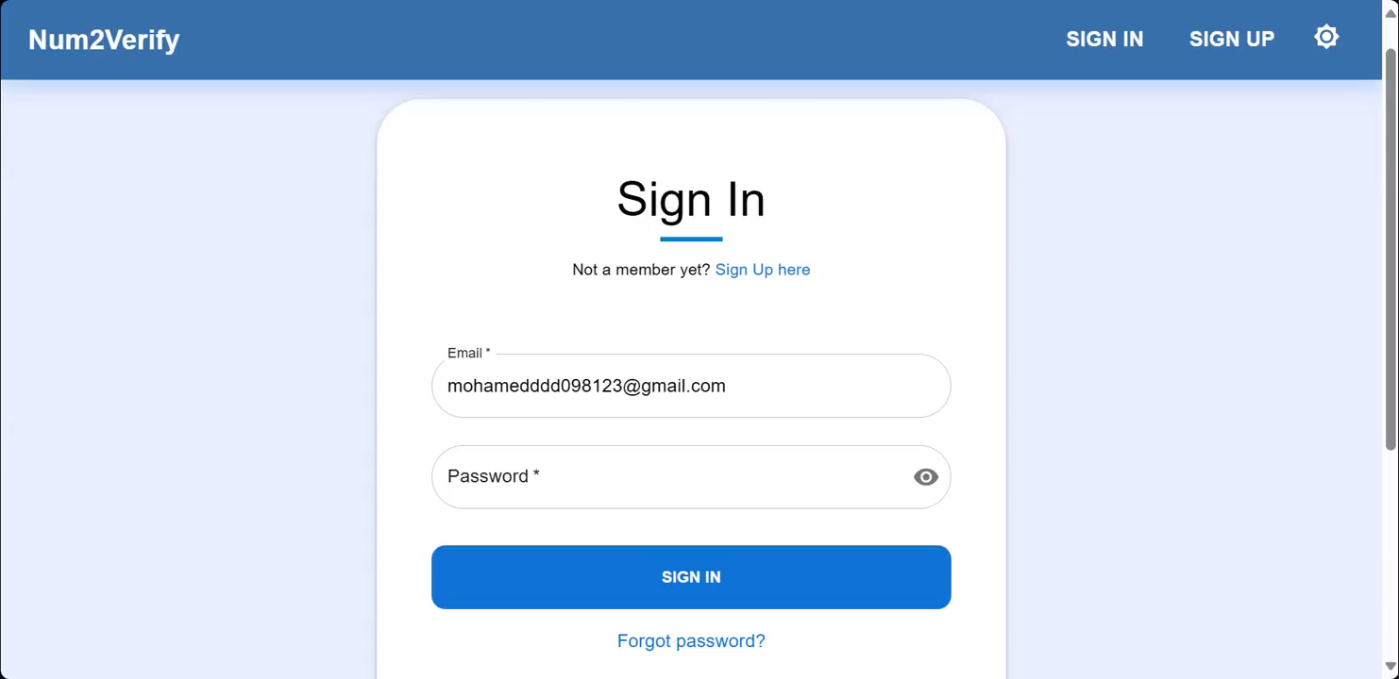
Sign In Page

Slide 17
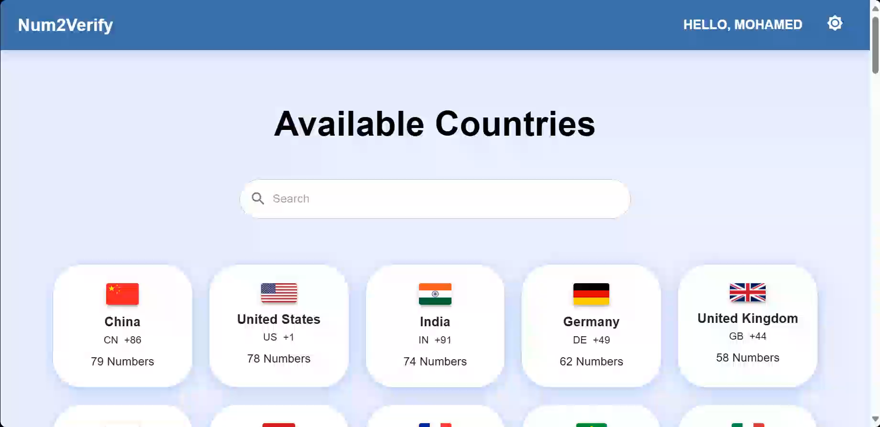
Country List Page

Slide 18
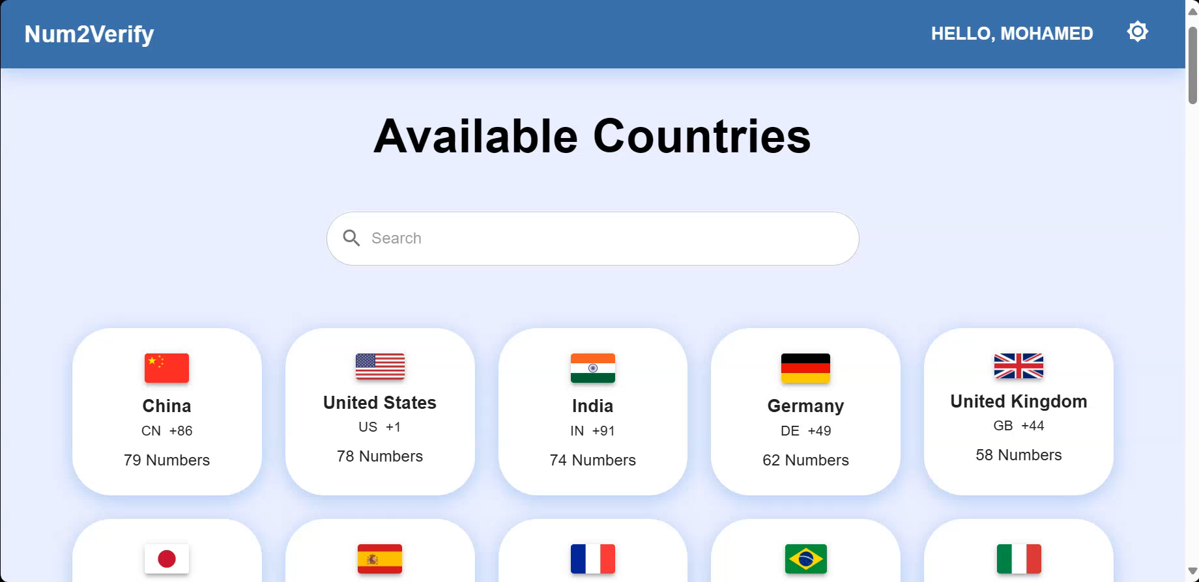
Country Numbers Page

Slide 19
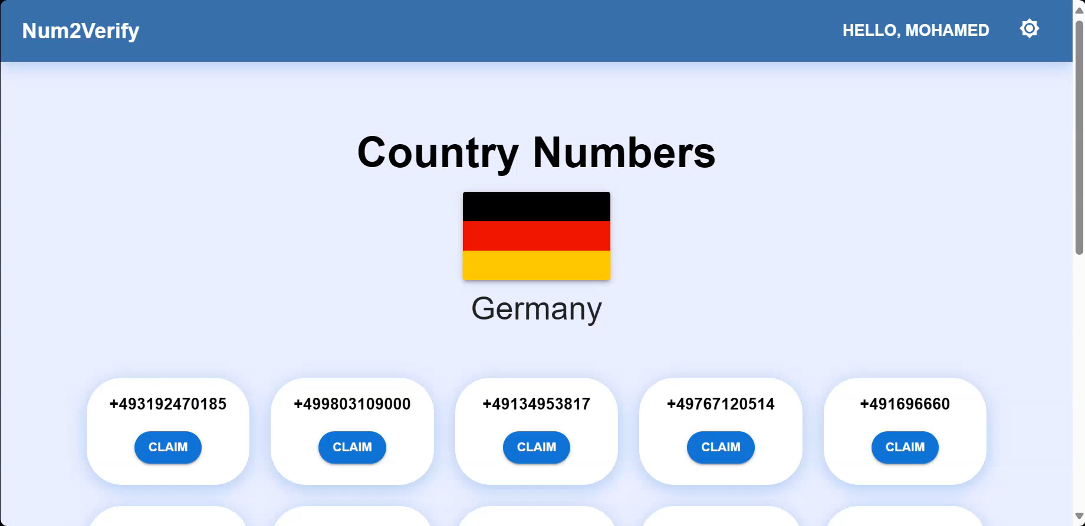
User Numbers Page

Slide 20
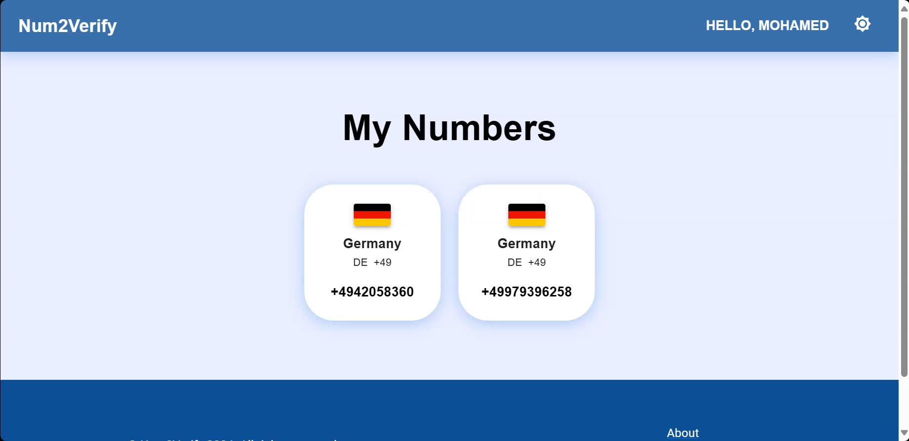
Number Messages Page

Slide 21
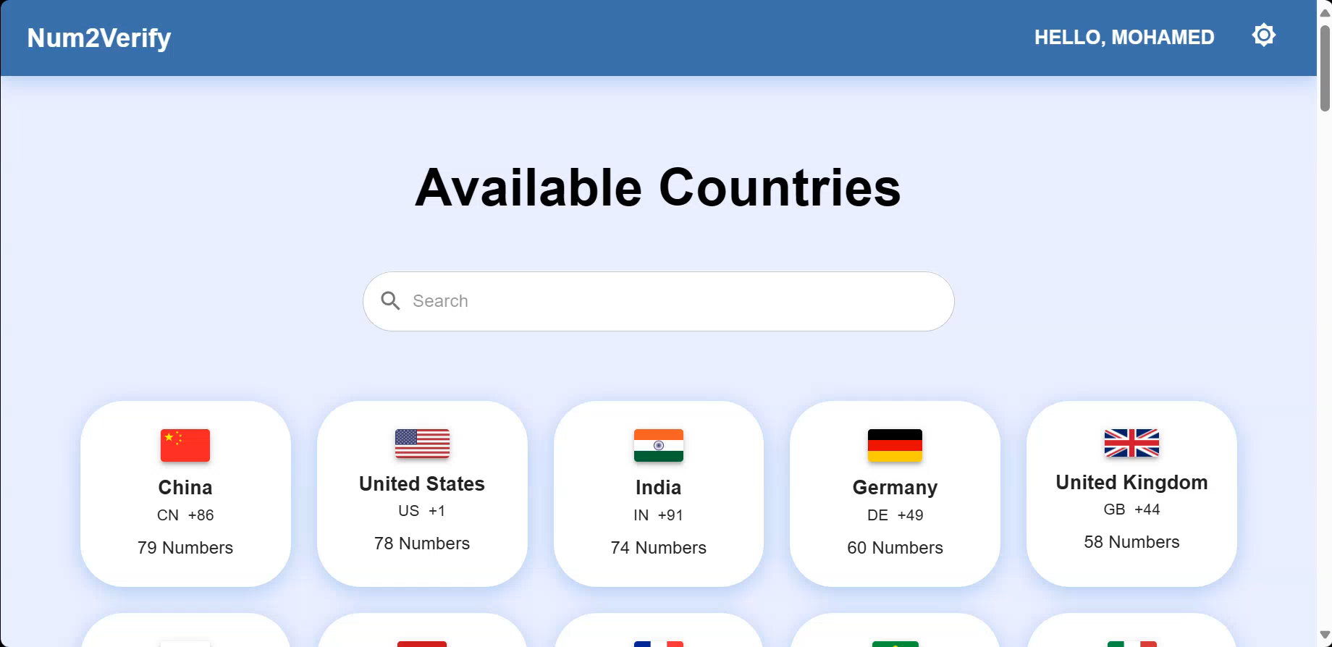
Profile Page

Slide 22
Back-end

Slide 23
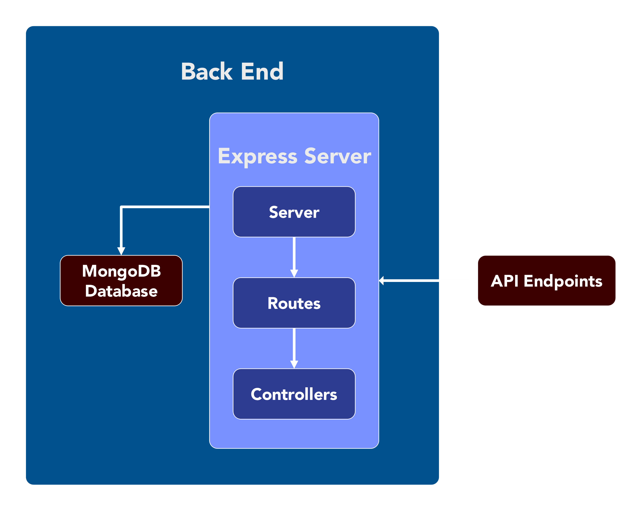
Back-End Structure

Slide 24
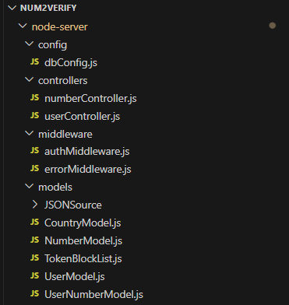
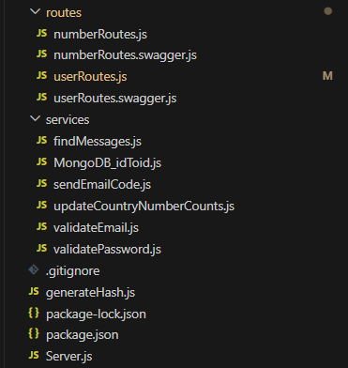
Backend Files

Slide 25
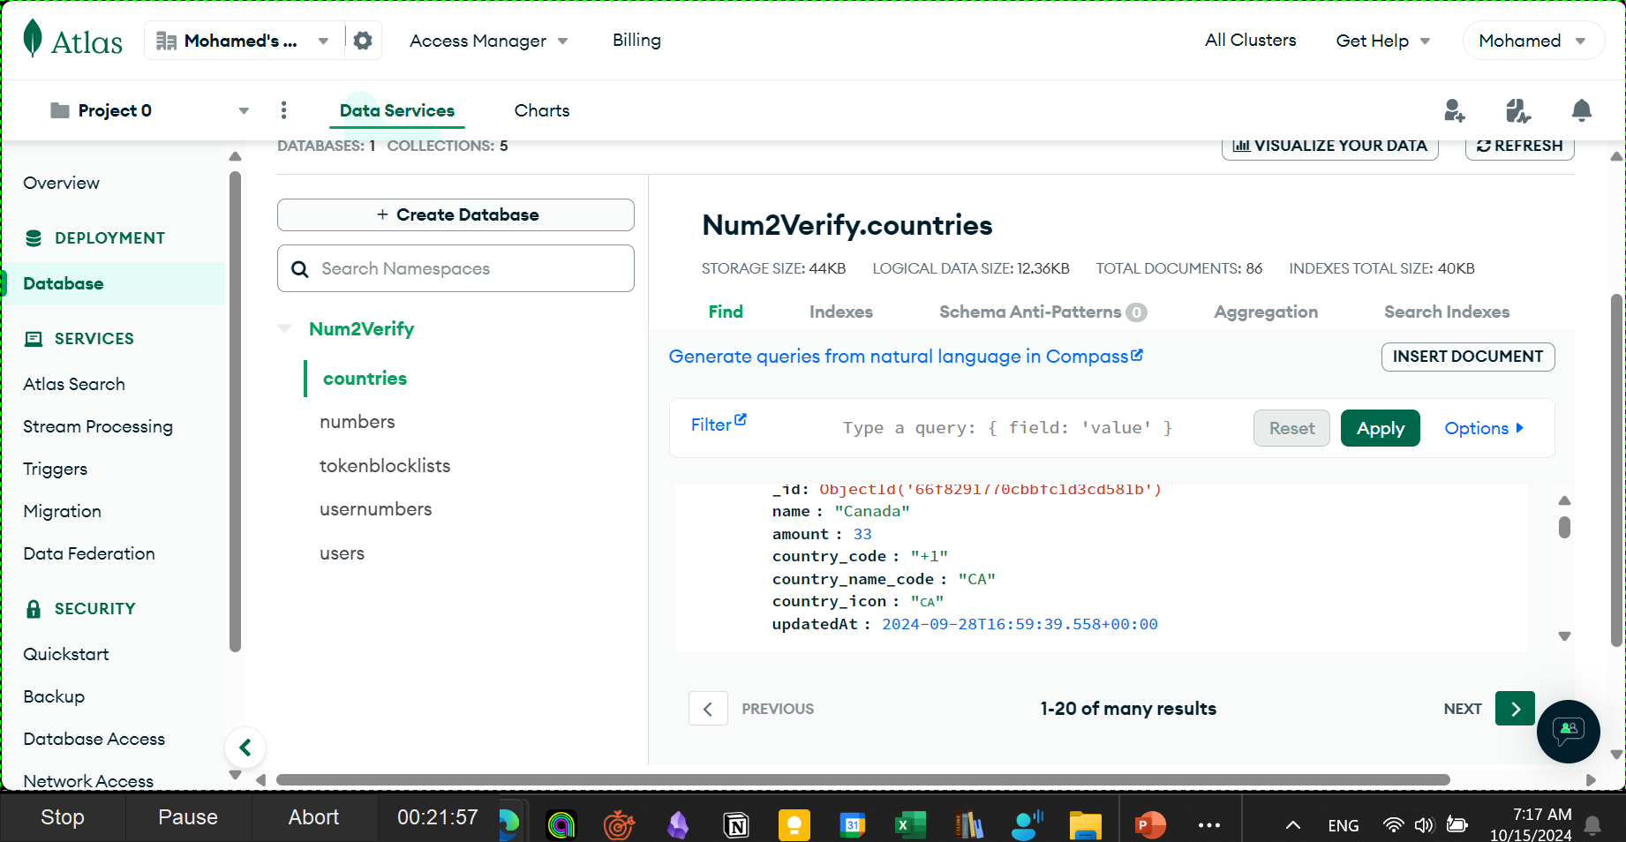
MongoDB Collections
We used MongoDB Atlas to Store the database

Slide 26
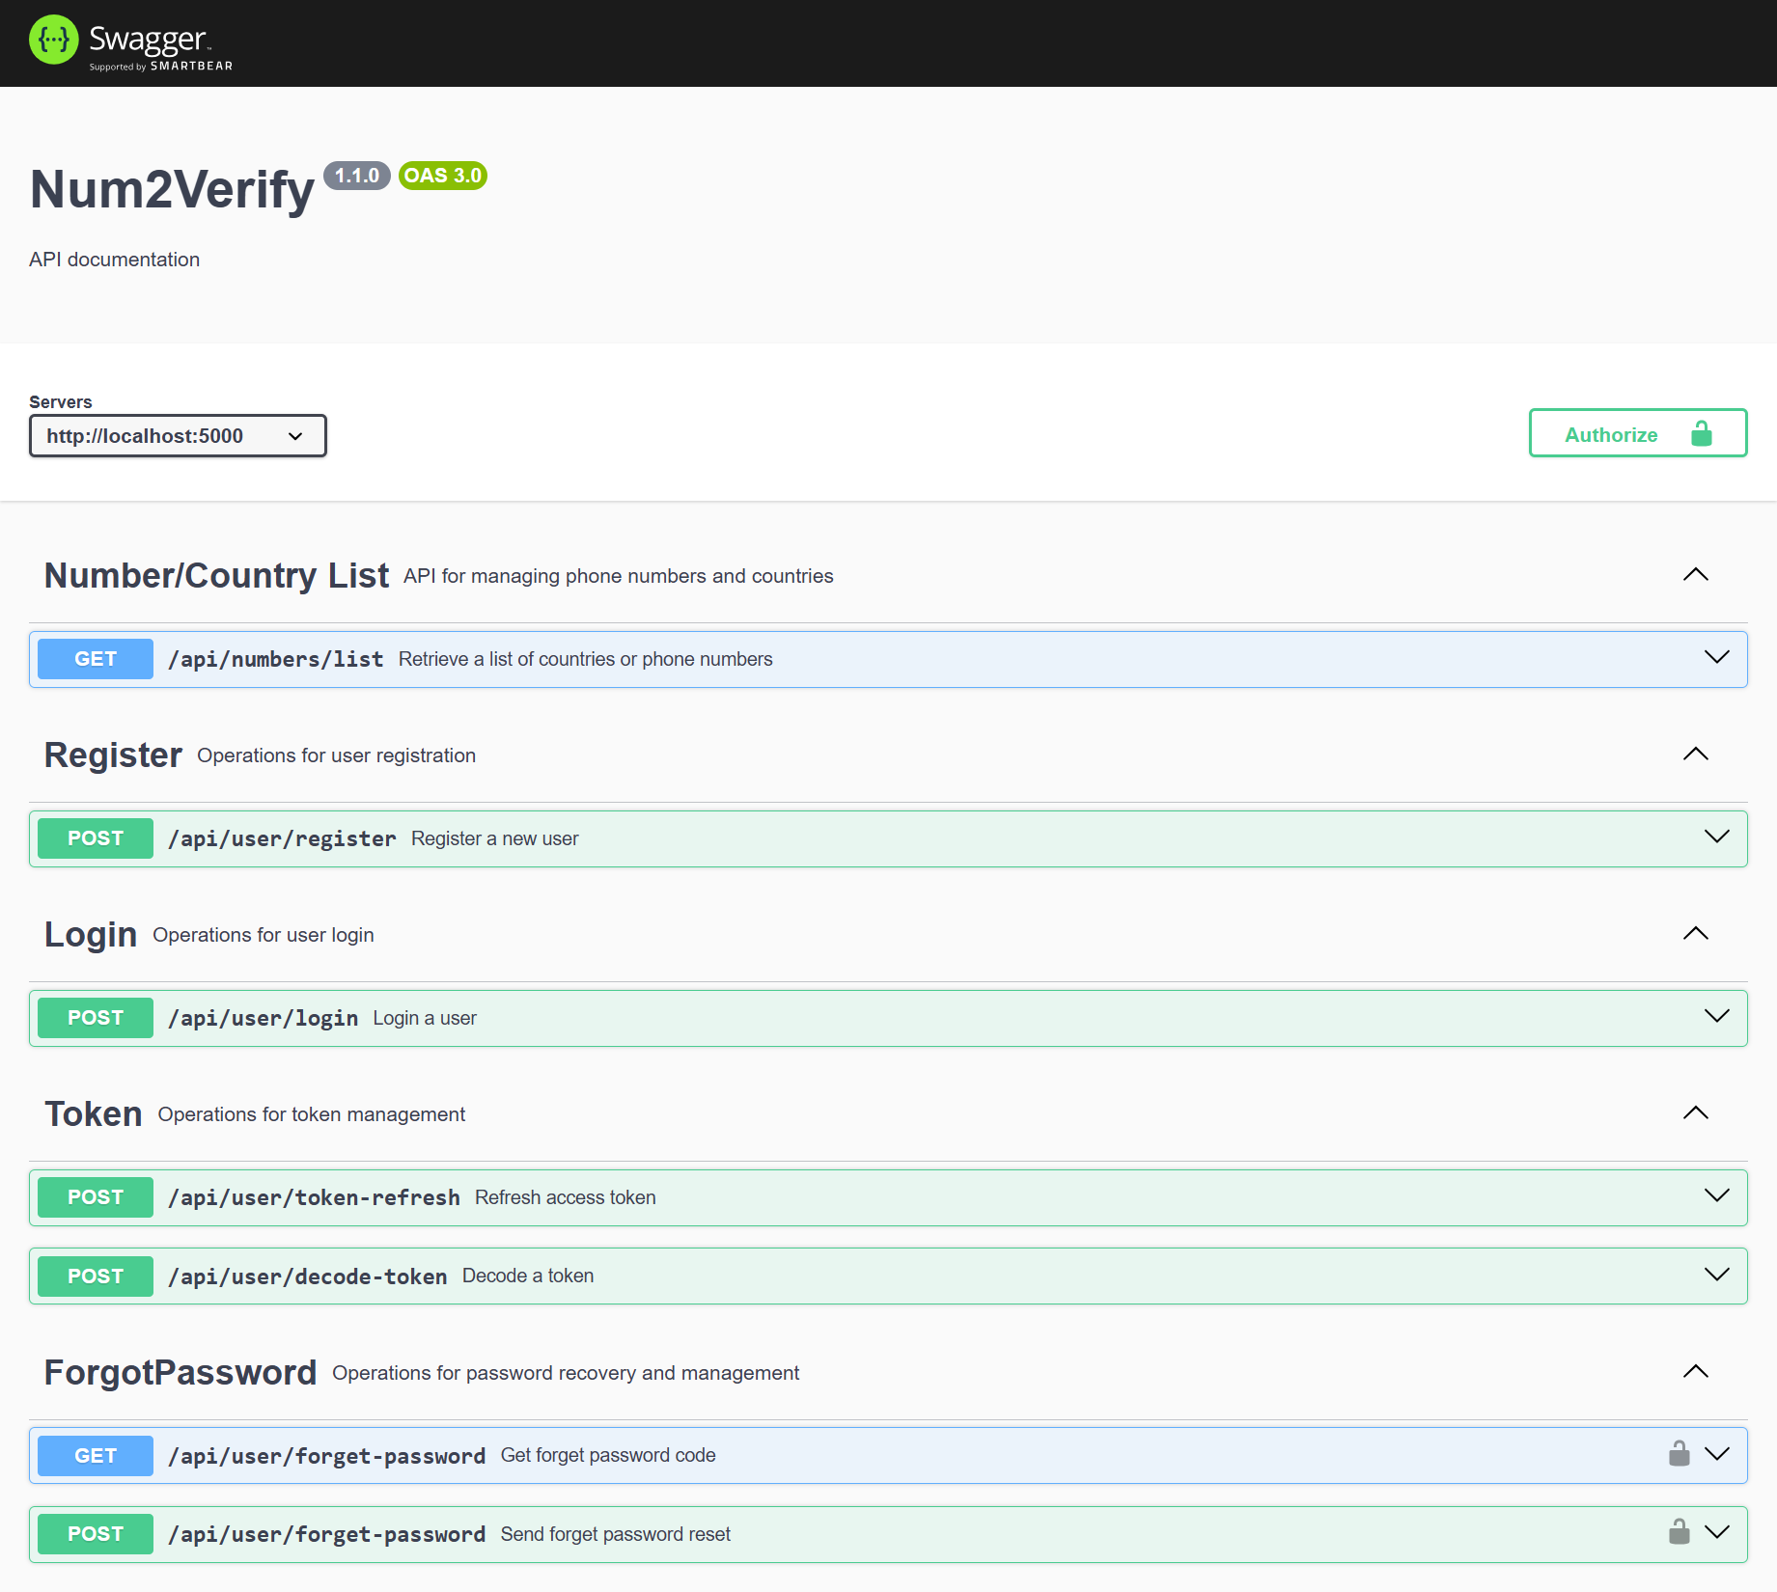
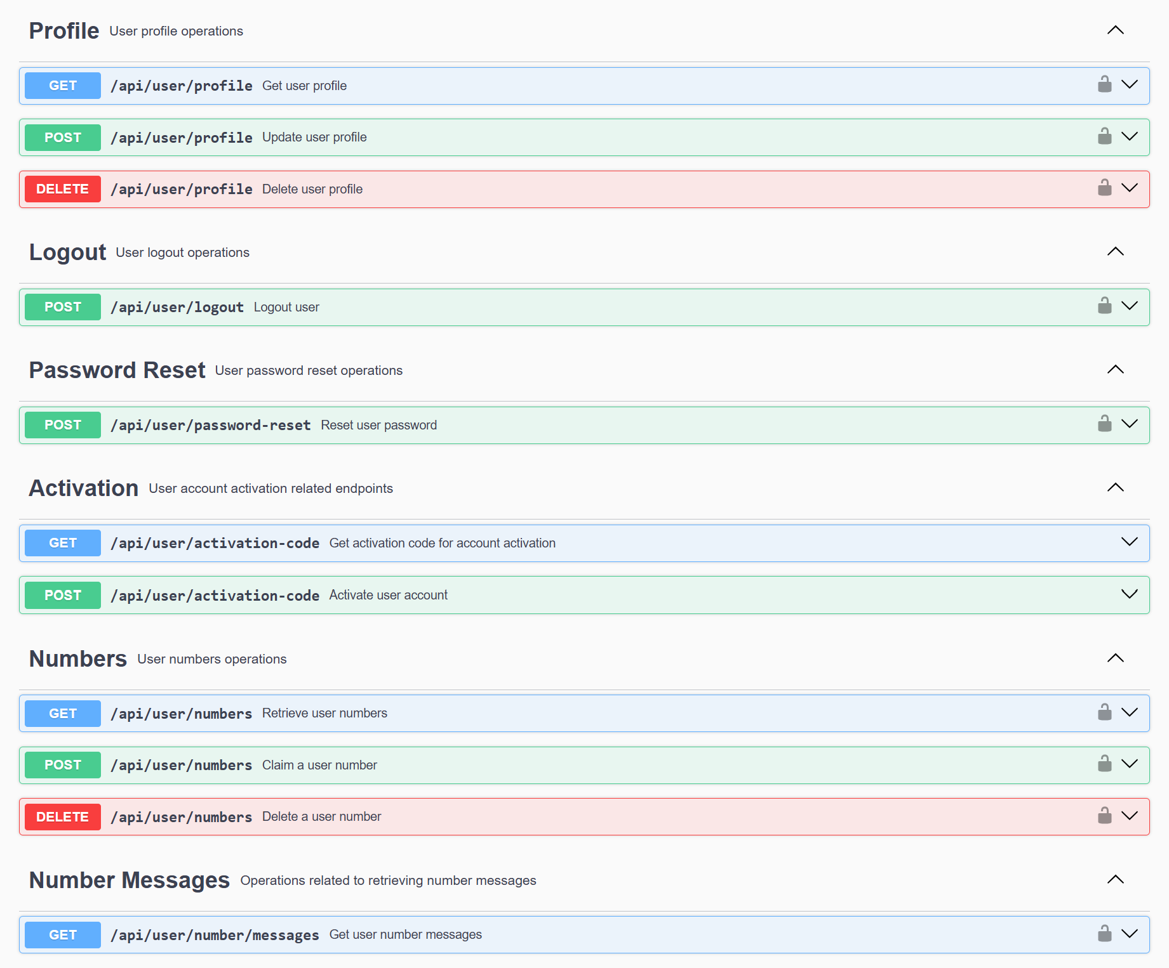
Swagger docs
We used the Swagger plugins to write swagger docs

Slide 27
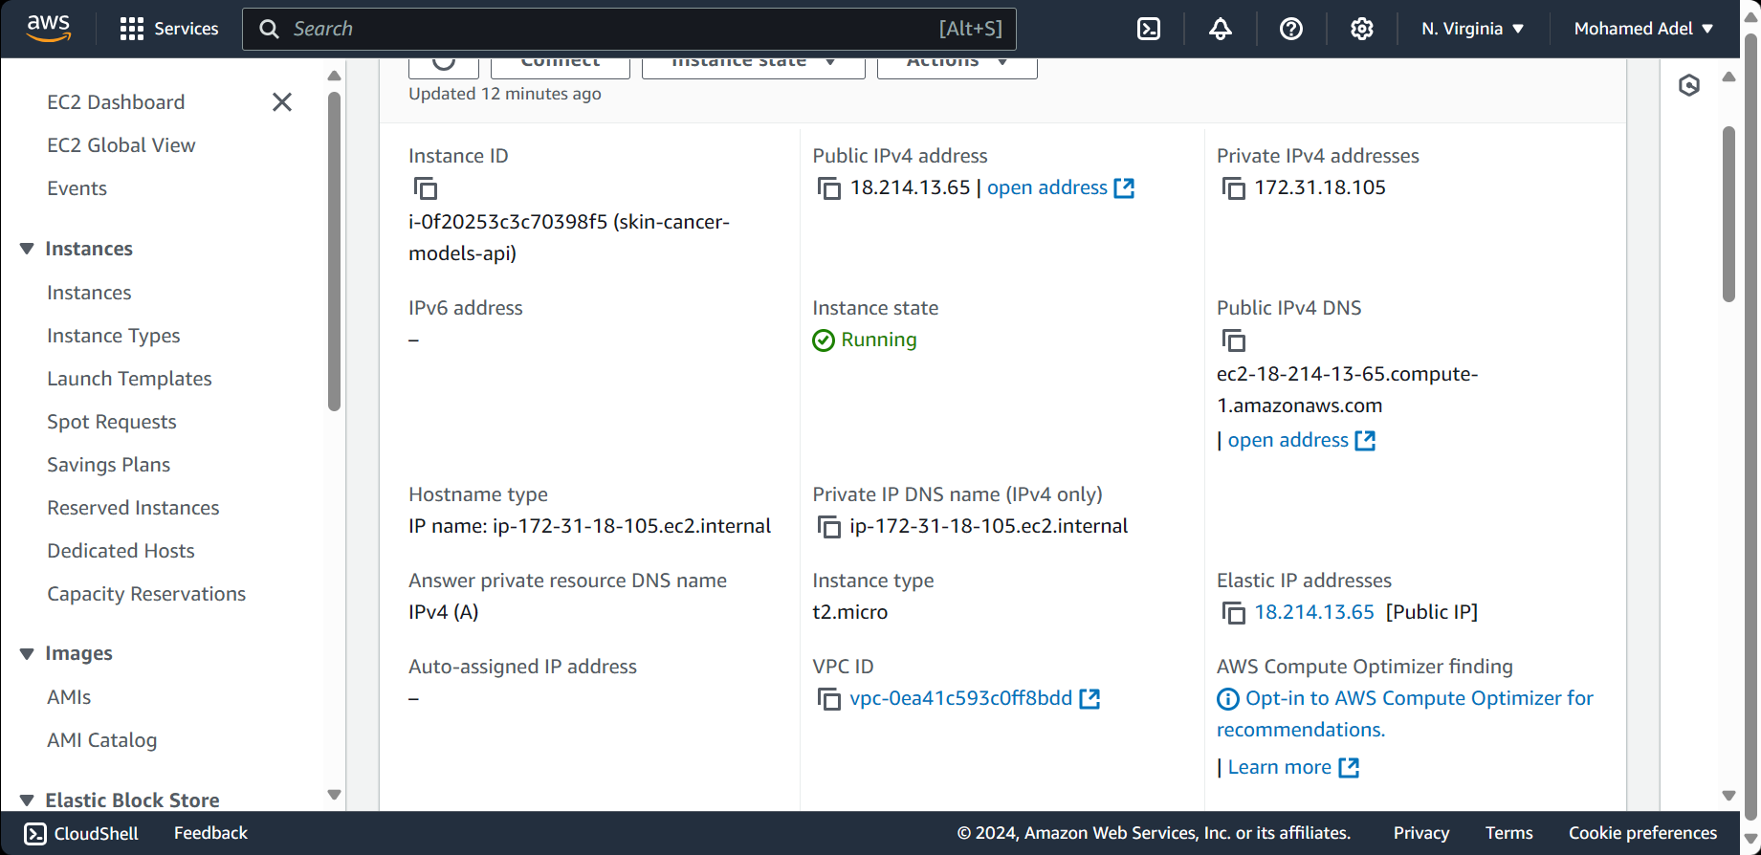
Deployment
The website was deployed to an AWS EC2 instance at
http://ec2-18-214-13-65.compute-1.amazonaws.com:5001 for the front-end, http://ec2-18-214-13-65.compute-1.amazonaws.com:5000 for the back-end.

Slide 28
Thank You ✨

